Slide 1
Ensemble Learning and Random Forests
By- Dr. Amit Rathi, Dept of CSE, JUET, Guna
Ref Book: Aurélien Géron

Slide 2
Random Forest
Random Forest is a supervised machine learning algorithm that uses many decision trees to make better predictions.
Developed by Leo Breiman and Adele Cutler, which combines the output of multiple decision trees to reach a single result.

Slide 3
Random Forest
It is widely used for both classification (predicting categories) & regression (predicting continuous numbers).
The algorithm relies on the principle of the "wisdom of the crowd," where the collective decision of many trees is more reliable than any single one.

Slide 4
Random Forest
Each tree looks at different random parts of the data and their results are combined by voting for classification or averaging for regression which makes it as ensemble learning technique.
This helps in improving accuracy and reducing errors.

Slide 5
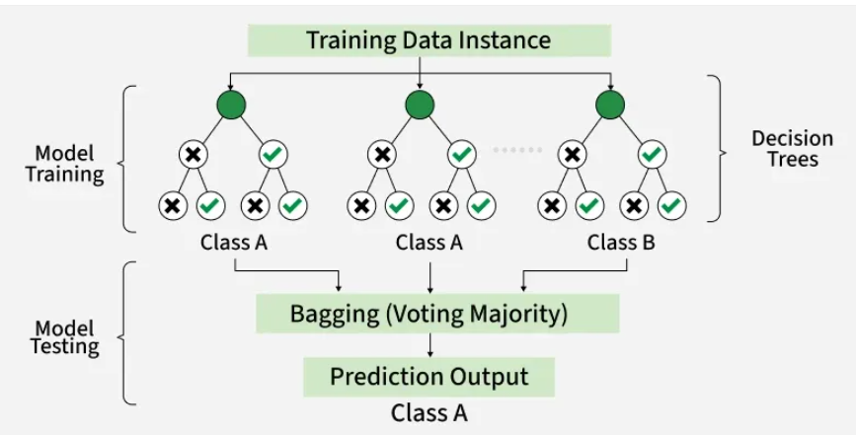
Random Forest

Slide 6
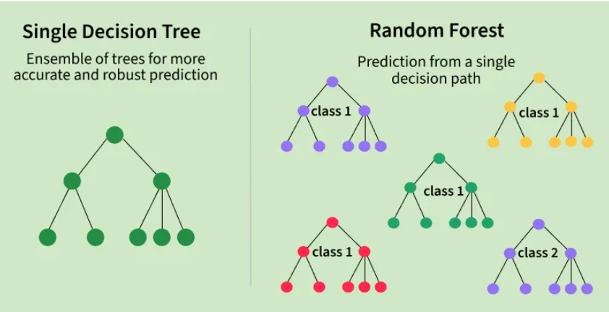
Random Forest

Slide 7
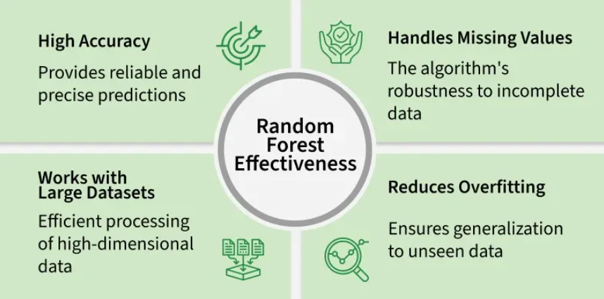
Random Forest

Slide 8
Random Forest
Key Advantages & Disadvantages
Pros:
  Handles missing values and large datasets efficiently.
  Provides a built-in measure of feature importance.
  Requires minimal data preprocessing (no scaling or normalization needed).
Cons:
  Can be computationally expensive and slow to train on massive data.
  Large models require significant memory for storage.
  Less effective for real-time predictions compared to simpler models.

Slide 9
Random Forest
Real-Life Analogy of Random Forest
A student named X wants to choose a course after his 10+2, and he cant decide which course fit for his skill set.
So he decides to consult various people like his cousins, teachers, parents, degree students, and working people.
He asks them varied questions like why he should choose, job opportunities with that course, course fee, etc.
Finally, after consulting various people about the course he decides to take the course suggested by most people.

Slide 10
Random Forest Applications
Customer churn prediction: Businesses can use random forests to predict which customers are likely to churn (cancel their service) so that they can take steps to retain them.
For example, a telecom company might use a random forest model to identify customers who are using their phone less frequently or who have a history of late payments.

Slide 11
Random Forest Applications
Fraud detection: Random forests can identify fraudulent transactions in real-time.
For instance, a bank might employ a random forest model to spot transactions made from unusual locations or involving unusually large amounts of money.
Stock price prediction: It can predict future stock prices.
However, it is important to note that stock price prediction is a very difficult task, and no model is ever going to be perfectly accurate.

Slide 12
Random Forest Applications
Medical diagnosis: These can help doctors diagnose diseases.
For example, a doctor might use a random forest model to help them diagnose a patient with cancer.
Image recognition: It can recognize objects in images.
For example, a self-driving car might use a random forest model to identify pedestrians and other vehicles on the road.

Slide 13
Working of Random Forest Algorithm
Before understanding the working of the random forest algorithm in machine learning, we must look into the ensemble learning technique.
Ensemble simply means combining multiple models.
Thus a collection of models is used to make predictions rather than an individual model.
Ensemble uses two types of methods:
Bagging (parallel) and Boosting (sequential).

Slide 14
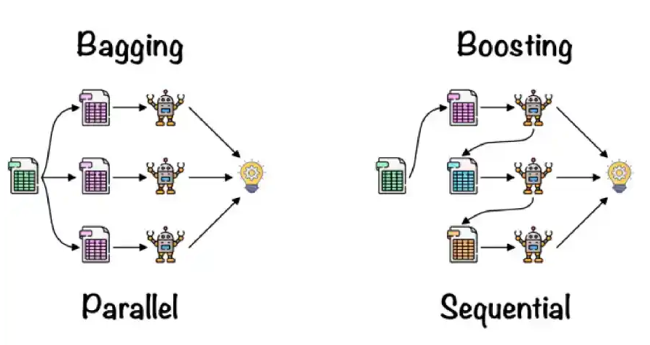
Working of Random Forest Algorithm

Slide 15
Bagging
Bagging, also known as Bootstrap Aggregation, serves as the ensemble technique in the Random Forest algorithm.
Steps involved in Bagging:
Selection of Subset: Bagging starts by choosing a random sample, or subset, from the entire dataset.
Bootstrap Sampling: Each model from these samples, called Bootstrap Samples, which we take from the original data with replacement.
This process is known as row sampling.

Slide 16
Bagging
Bootstrapping: The step of row sampling with replacement is referred to as bootstrapping.
Independent Model Training: We train each model independently on its corresponding Bootstrap.
This training process generates results for each model.

Slide 17
Bagging
Majority Voting: The final output by combining the results of all models through majority voting.
We select the most commonly predicted outcome among the models.
Aggregation: This step by combining all the results and generating the final output based on majority voting, which we call aggregation.

Slide 18
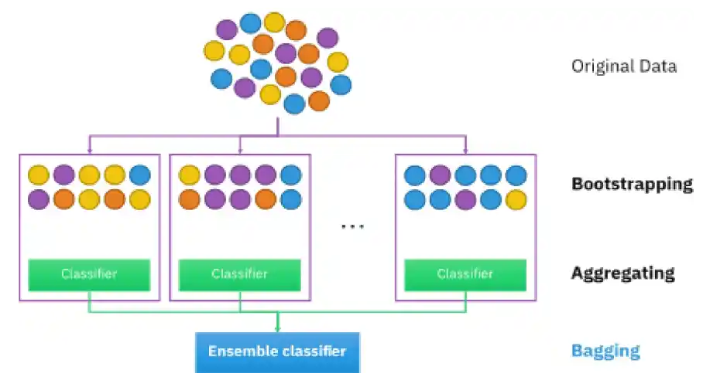
Bagging

Slide 19
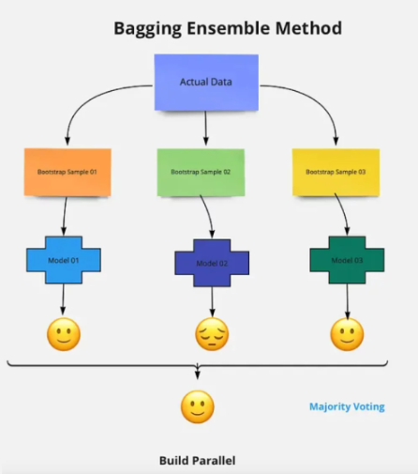
Bagging
Now let’s look at an example by breaking it down with the help of the following figure.

Slide 20
Bagging
Here the bootstrap sample is taken from actual data (Bootstrap sample 01, Bootstrap sample 02, and Bootstrap sample 03) with a replacement which means there is a high possibility that each sample won’t contain unique data.
The model (Model 01, Model 02, and Model 03) obtained from this bootstrap sample is trained independently.
Each model generates results as shown.
Now the Happy emoji has a majority when compared to the Sad emoji.
Thus based on majority voting final output is obtained as Happy emoji.

Slide 21
Boosting
Boosting is one of the techniques that use the concept of ensemble learning.
A boosting algorithm combines multiple simple models (also known as weak learners or base estimators) to generate the final output.
It is done by building a model by using weak models in series.

Slide 22
Boosting
There are several boosting algorithms; AdaBoost was the first really successful boosting algorithm that was developed for the purpose of binary classification.
AdaBoost is an abbreviation for Adaptive Boosting and is a prevalent boosting technique that combines multiple “weak classifiers” into a single “strong classifier.” There are Other Boosting techniques.
4 Boosting Algorithms You Should Know: GBM, XGBoost, LightGBM & CatBoost.

Slide 23
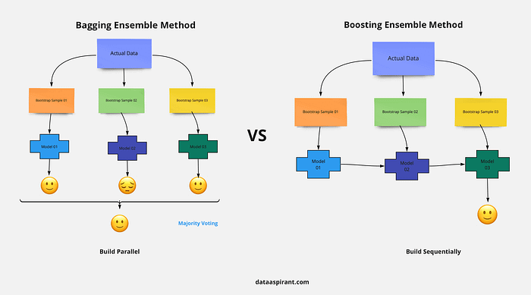

Slide 24
Boosting
Boosting in the context of random forests refers to a distinct, superior ensemble technique — Gradient Boosting or AdaBoost—that improves upon a random forest's predictive accuracy by training trees sequentially rather than independently.
While Random Forest uses bagging to reduce variance by averaging trees in parallel, Boosting reduces bias by focusing on previous trees' errors.

Slide 25
Key Differences: Boosting vs. Random Forest (Bagging)
Methodology: Random Forest constructs trees independently and in parallel. Boosting (e.g., Gradient Boosting) builds trees sequentially, with each new tree attempting to correct the errors (residuals) of the combined previous trees.
Tree Dependence: In Random Forest, trees are independent. In Boosting, each tree depends on the prior tree's mistakes.
Error Correction: Boosting assigns higher weights to misclassified data points to force subsequent models to focus on difficult cases.
Overfitting: Random forests are less prone to overfitting due to independent parallel training. Boosting, if not properly tuned, is more susceptible to overfitting because it focuses heavily on minimizing training error.

Slide 26
Steps Involved in Random Forest Algorithm
Step 1: In this model, we select a subset of data points and a subset of features to construct each decision tree. Simply put, we take n random records and m features from a dataset containing k records.
Step 2: We construct individual decision trees for each sample.
Step 3: Each decision tree will generate an output.
Step 4: We consider the final output based on Majority Voting for classification and Averaging for regression, respectively.
Share
Rewrite

Slide 27
Steps Involved in Random Forest Algorithm
For example:
Consider the fruit basket as the data as shown in the figure.
Now n number of samples are taken from the fruit basket, and an individual decision tree is constructed for each sample.
Each decision tree will generate an output, as shown in the figure.
The final output based on majority voting.
In the figure, you can see that the majority decision tree outputs an apple compared to a banana, so we take the final output as an apple.

Slide 28
Important Features of Random Forest
Random Forest is distinguished by several key features that contribute to its effectiveness and versatility:
Diversity: Each decision tree in the Random Forest is built from a different subset of data and features. This diversity helps in reducing overfitting and improving the model’s generalization capability.
Robustness: By averaging the results from multiple trees, Random Forest reduces the variance and improves the robustness of the predictions.

Slide 29
Important Features of Random Forest
Handling of Missing Values: It can handle missing values internally by using surrogate splits or by averaging results from other trees that do not have missing values for the same data points.
Feature Importance: It provides insights into the importance of each feature in the prediction process.
This can be particularly useful for feature selection and understanding the underlying data patterns.

Slide 30
Important Features of Random Forest
Scalability: Random Forest can be parallelized because each tree is built independently of the others. This makes it scalable to large datasets and high-dimensional data.
Versatility: It can be used for both classification and regression tasks. The algorithm is also effective for tasks involving categorical and continuous variables.
Stability: Due to the ensemble nature, It is less sensitive to changes in the training data compared to a single decision tree.

Slide 31
Important Features of Random Forest
Out-of-Bag Error Estimation: Random Forest provides an internal mechanism for estimating the model error without the need for a separate validation set.
This is done using the out-of-bag (OOB) samples, which are not used in the construction of each tree.

Slide 32
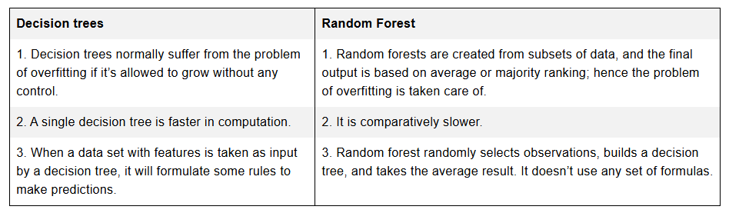
Difference Between Decision Tree and Random Forest
Random forest is a collection of decision trees; still, there are a lot of differences in their behavior.

Slide 33
Ensemble Learning and Random Forests (Aurélien Géron)
Suppose you pose a complex question to thousands of random people, then aggregate their answers.
In many cases you will find that this aggregated answer is better than an expert’s answer.
This is called the wisdom of the crowd.
Similarly, if you aggregate the predictions of a group of predictors (such as classifiers or regressors), you will often get better predictions than with the best individual predictor.
A group of predictors is called an ensemble; thus, this technique is called Ensemble Learning, and an Ensemble Learning algorithm is called an Ensemble method.

Slide 34
Ensemble Learning and Random Forests (Aurélien Géron)
As an example of an Ensemble method, you can train a group of Decision Tree classifiers, each on a different random subset of the training set.
To make predictions, you obtain the predictions of all the individual trees, then predict the class that gets the most votes.
Such an ensemble of Decision Trees is called a Random Forest, and despite its simplicity, this is one of the most powerful Machine Learning algorithms available today.
The most popular Ensemble methods, including bag‐ ging, boosting, and stacking.

Slide 35
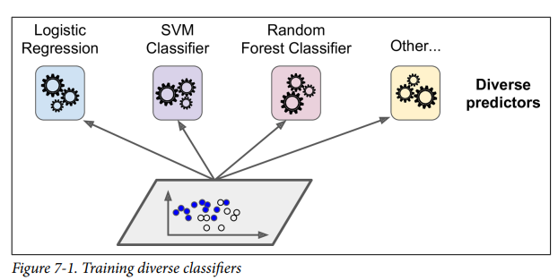
Voting Classifiers (Aurélien Géron)
Suppose we have trained a few classifiers, each one achieving about 80% accuracy. You may have a Logistic Regression classifier, an SVM classifier, a Random Forest classifier, a K-Nearest Neighbors classifier, and perhaps a few more (see Figure 7-1).

Slide 36
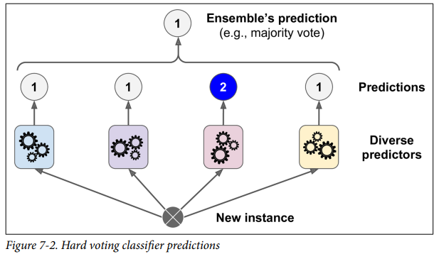
Voting Classifiers (Aurélien Géron)
A very simple way to create an even better classifier is to aggregate the predictions of each classifier and predict the class that gets the most votes. This majority-vote classifier is called a hard voting classifier (see Figure 7-2).

Slide 37
Voting Classifiers (Aurélien Géron)
Ensemble methods work best when the predictors are as independent from one another as possible.
One way to get diverse classifiers is to train them using different algorithms.
This increases the chance that they will make very different types of errors, improving the ensemble’s accuracy.

Slide 38
Bagging and Pasting
One way to get a diverse set of classifiers is to use very different training algorithms.
Another approach is to use the same training algorithm for every predictor and train them on different random subsets of the training set.
When sampling is performed with replacement, this method is called bagging (short for boot‐ strap aggregating ).
When sampling is performed without replacement, it is called pasting.

Slide 39
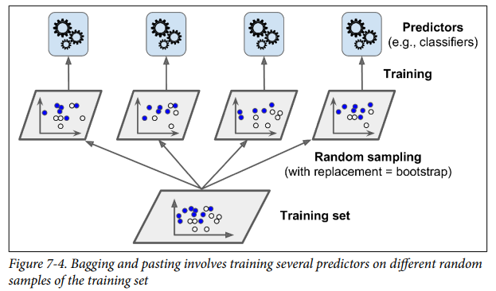
Bagging and Pasting
In other words, both bagging and pasting allow training instances to be sampled several times across multiple predictors, but only bagging allows training instances to be sampled several times for the same predictor.
This sampling and training process is represented in Figure 7-4.

Slide 40
Bagging and Pasting
Once all predictors are trained, the ensemble can make a prediction for a new instance by simply aggregating the predictions of all predictors.
The aggregation function is typically the statistical mode (i.e., the most frequent prediction, just like a hard voting classifier) for classification, or the average for regression.
Each individual predictor has a higher bias than if it were trained on the original training set, but aggregation reduces both bias and variance.

Slide 41
Bagging and Pasting
Generally, the net result is that the ensemble has a similar bias but a lower variance than a single predictor trained on the original training set.
As you can see in Figure 7-4, predictors can all be trained in parallel, via different CPU cores or even different servers.
Similarly, predictions can be made in parallel.
This is one of the reasons bagging and pasting are such popular methods: they scale very well.

Slide 42
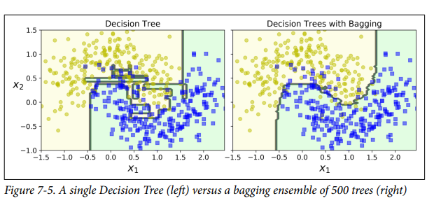
Bagging and Pasting

Slide 43
Bagging and Pasting
Bootstrapping introduces a bit more diversity in the subsets that each predictor is trained on,
so bagging ends up with a slightly higher bias than pasting;
but the extra diversity also means that the predictors end up being less correlated,
so the ensemble’s variance is reduced.

Slide 44
Bagging and Pasting
Overall, bagging often results in better models,
which explains why it is generally preferred.
However, if you have spare time and CPU power,
you can use cross-validation to evaluate both bagging and pasting and select the one that works best.

Slide 45
Out-of-Bag Evaluation
With bagging, some instances may be sampled several times for any given predictor, while others may not be sampled at all.
By default a BaggingClassifier samples m training instances with replacement (bootstrap=True), where m is the size of the training set.

Slide 46
Out-of-Bag Evaluation
This means that only about 63% of the training instances are sampled on average for each predictor.
The remaining 37% of the training instances that are not sampled are called out-of-bag (oob) instances.
Note that they are not the same 37% for all predictors.

Slide 47
Out-of-Bag Evaluation
Since a predictor never sees the oob instances during training,
it can be evaluated on these instances, without the need for a separate validation set.
We can evaluate the ensemble itself by averaging out the oob evaluations of each predictor.

Slide 48
Random Patches and Random Subspaces
The BaggingClassifier class supports sampling the features as well.
Sampling is controlled by two hyper parameters: max_features and bootstrap_features.
They work the same way as max_samples and bootstrap, but for feature sampling instead of instance sampling.

Slide 49
Random Patches and Random Subspaces
Thus, each predictor will be trained on a random subset of the input features.
This technique is particularly useful when you are dealing with high-dimensional inputs (such as images).
Sampling both training instances and features is called the Random Patches method.

Slide 50
Random Patches and Random Subspaces
Keeping all training instances s (by setting bootstrap=False and max_samples=1.0) but sampling features (by setting bootstrap_features to True and/or max_features to a value smaller than 1.0) is called the Random Subspaces method.
Sampling features results in even more predictor diversity, trading a bit more bias for a lower variance.

Slide 51
Random Forests
A Random Forest is an ensemble of Decision Trees, generally trained via the bagging method (or sometimes pasting), typically with max_samples set to the size of the training set.
Instead of building a BaggingClassifier and passing it a DecisionTreeClassifier, we can instead use the RandomForestClassifier class, which is more convenient and optimized for Decision Trees (similarly, there is a RandomForestRegressor class for regression tasks).

Slide 52
Random Forests
With a few exceptions, a RandomForestClassifier has all the hyperparameters of a DecisionTreeClassifier (to control how trees are grown), plus all the hyperparameters of a BaggingClassifier to control the ensemble itself.
The Random Forest algorithm introduces extra randomness when growing trees; instead of searching for the very best feature when splitting a node, it searches for the best feature among a random subset of features.
The algorithm results in greater tree diversity, which (again) trades a higher bias for a lower variance, generally yielding an overall better model.

Slide 53
Extra-Trees
When you are growing a tree in a Random Forest, at each node only a random subset of the features is considered for splitting (as discussed earlier).
It is possible to make trees even more random by also using random thresholds for each feature rather than searching for the best possible thresholds (like regular Decision Trees do).

Slide 54
Extra-Trees
A forest of such extremely random trees is called an Extremely Randomized Trees ensemble (or Extra-Trees for short).
Once again, this technique trades more bias for a lower variance.
It also makes Extra-Trees much faster to train than regular Random Forests, because finding the best possible threshold for each feature at every node is one of the most time-consuming tasks of growing a tree.

Slide 55
Feature Importance
Yet another great quality of Random Forests is that they make it easy to measure the relative importance of each feature.
Scikit-Learn measures a feature’s importance by looking at how much the tree nodes that use that feature reduce impurity on average (across all trees in the forest).

Slide 56
Feature Importance
More precisely, it is a weighted average, where each node’s weight is equal to the number of training samples that are associated with it.
Scikit-Learn computes this score automatically for each feature after training, then it scales the results so that the sum of all importances is equal to 1.

Slide 57
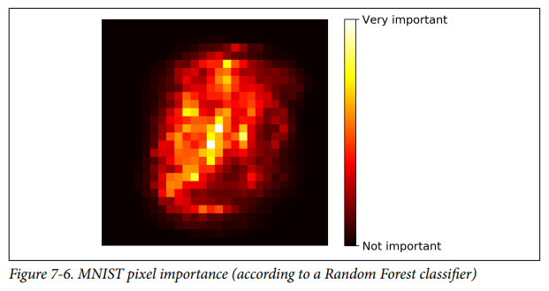
Feature Importance
Similarly, if you train a Random Forest classifier on the MNIST dataset and plot each pixel’s importance, you get the image represented in Figure 7-6.
Random Forests are very handy to get a quick understanding of what features actually matter, in particular if we need to perform feature selection.

Slide 58
Boosting
Boosting (originally called hypothesis boosting) refers to any Ensemble method that can combine several weak learners into a strong learner.
The general idea of most boosting methods is to train predictors sequentially, each trying to correct its predecessor.
There are many boosting methods available, but by far the most popular are AdaBoost (short for Adaptive Boosting) and Gradient Boosting.

Slide 59
AdaBoost (Adaptive Boosting)
One way for a new predictor to correct its predecessor is to pay a bit more attention to the training instances that the predecessor underfitted.
This results in new predictors focusing more and more on the hard cases.
This is the technique used by AdaBoost.

Slide 60
AdaBoost (Adaptive Boosting)
For example, when training an AdaBoost classifier, the algorithm first trains a base classifier (such as a Decision Tree) and uses it to make predictions on the training set.
The algorithm then increases the relative weight of misclassified training instances.
Then it trains a second classifier, using the updated weights, and again makes predictions on the training set, updates the instance weights, and so on (see Figure 7-7).

Slide 61
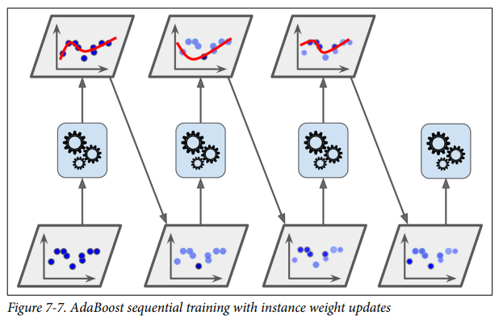
AdaBoost (Adaptive Boosting)

Slide 62
AdaBoost (Adaptive Boosting)
Figure 7-8 shows the decision boundaries of five consecutive predictors on the moons dataset (in this example, each predictor is a highly regularized SVM classifier with an RBF kernel.
The first classifier gets many instances wrong, so their weights get boosted. The second classifier therefore does a better job on these instances, and so on.

Slide 63
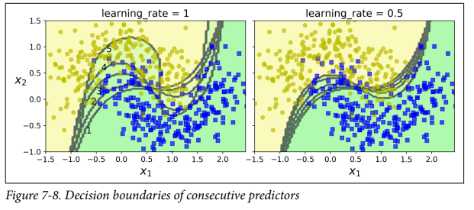
AdaBoost (Adaptive Boosting)

Slide 64
AdaBoost (Adaptive Boosting)
The plot on the right represents the same sequence of predictors, except that the learning rate is halved (i.e., the misclassified instance weights are boosted half as much at every iteration).
As we can see, this sequential learning technique has some similarities with Gradient Descent, except that instead of tweaking a single predictor’s parameters to minimize a cost function, AdaBoost adds predictors to the ensemble, gradually making it better.

Slide 65
AdaBoost (Adaptive Boosting)
Once all predictors are trained, the ensemble makes predictions very much like bag‐ ging or pasting, except that predictors have different weights depending on their overall accuracy on the weighted training set.
There is one important drawback to this sequential learning technique: it cannot be parallelized (or only partially), since each predictor can only be trained after the previous predictor has been trained and evaluated.
As a result, it does not scale as well as bagging or pasting.

Slide 66
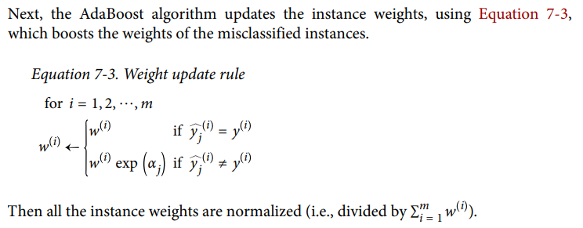
AdaBoost (Adaptive Boosting)

Slide 67
AdaBoost (Adaptive Boosting)
Once all predictors are trained, the ensemble makes predictions very much like bag‐ ging or pasting, except that predictors have different weights depending on their overall accuracy on the weighted training set.
There is one important drawback to this sequential learning technique: it cannot be parallelized (or only partially), since each predictor can only be trained after the previous predictor has been trained and evaluated.
As a result, it does not scale as well as bagging or pasting.

Slide 68
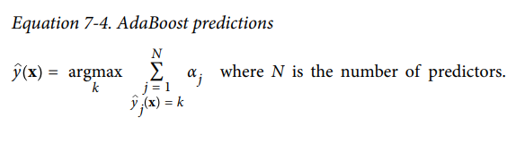
AdaBoost (Adaptive Boosting)
To make predictions, AdaBoost simply computes the predictions of all the predictors and weighs them using the predictor weights αj .
The predicted class is the one that receives the majority of weighted votes (see Equation 7-4).

Slide 69
AdaBoost (Adaptive Boosting)
If your AdaBoost ensemble is overfitting the training set, you can try reducing the number of estimators or more strongly regularizing the base estimator.

Slide 70
Gradient Boosting
Another very popular boosting algorithm is Gradient Boosting.
Just like AdaBoost, Gradient Boosting works by sequentially adding predictors to an ensemble, each one correcting its predecessor.
However, instead of tweaking the instance weights at every iteration like AdaBoost does, this method tries to fit the new predictor to the residual errors made by the previous predictor.

Slide 71
Gradient Boosting
Let’s go through a simple regression example, using Decision Trees as the base predictors (of course, Gradient Boosting also works great with regression tasks).
This is called Gradient Tree Boosting, or Gradient Boosted Regression Trees (GBRT).

Slide 72
Gradient Boosting
Figure 7-9 represents the predictions of these three trees in the left column, and the ensemble’s predictions in the right column.
In the first row, the ensemble has just one tree, so its predictions are exactly the same as the first tree’s predictions.

Slide 73
Gradient Boosting
In the second row, a new tree is trained on the residual errors of the first tree.
On the right you can see that the ensemble’s predictions are equal to the sum of the predictions of the first two trees.

Slide 74
Gradient Boosting
Similarly, in the third row another tree is trained on the residual errors of the second tree.
You can see that the ensemble’s predictions gradually get better as trees are added to the ensemble.

Slide 75
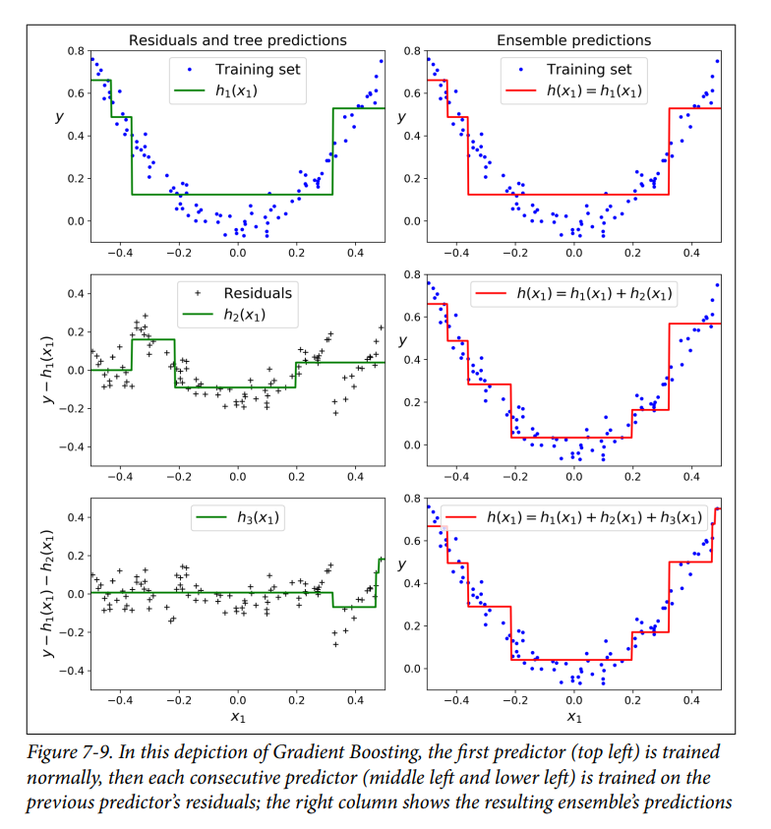
Gradient Boosting

Slide 76
Gradient Boosting
The learning_rate hyperparameter scales the contribution of each tree.
If you set it to a low value, such as 0.1, you will need more trees in the ensemble to fit the training set, but the predictions will usually generalize better.

Slide 77
Gradient Boosting
This is a regularization tech‐ nique called shrinkage.
Figure 7-10 shows two GBRT ensembles trained with a low learning rate: the one on the left does not have enough trees to fit the training set, while the one on the right has too many trees and overfits the training set.
In order to find the optimal number of trees, you can use early stopping.

Slide 78
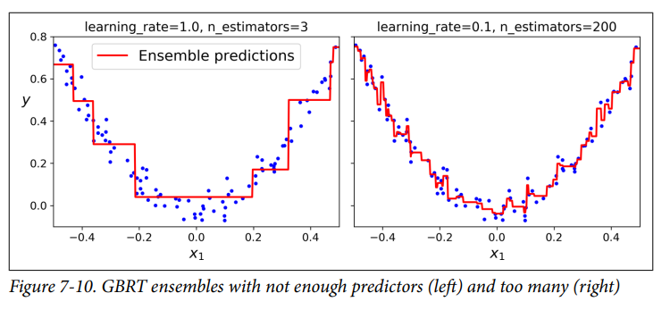
Gradient Boosting

Slide 79
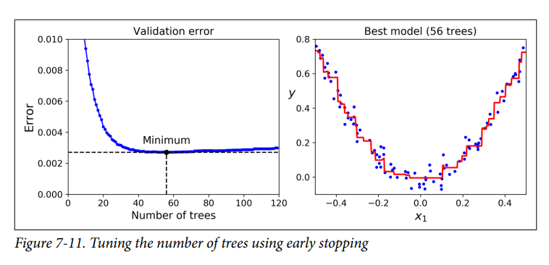
Gradient Boosting
The validation errors are represented on the left of Figure 7-11, and the best model’s predictions are represented on the right.

Slide 80
Gradient Boosting
It is worth noting that an optimized implementation of Gradient Boosting is available in the popular Python library XGBoost, which stands for Extreme Gradient Boosting.
This package was initially developed by Tianqi Chen as part of the Distributed (Deep) Machine Learning Community (DMLC), and it aims to be extremely fast, scalable, and portable.

Slide 81
Stacking
The last Ensemble method we will discuss in this chapter is called stacking (short for stacked generalization).
It is based on a simple idea: instead of using trivial functions (such as hard voting) to aggregate the predictions of all predictors in an ensemble, why don’t we train a model to perform this aggregation?

Slide 82
Stacking
Figure 7-12 shows such an ensemble performing a regression task on a new instance.
Each of the bottom three predictors predicts a different value (3.1, 2.7, and 2.9), and then the final predictor (called a blender, or a meta learner) takes these predictions as inputs and makes the final prediction (3.0).

Slide 83
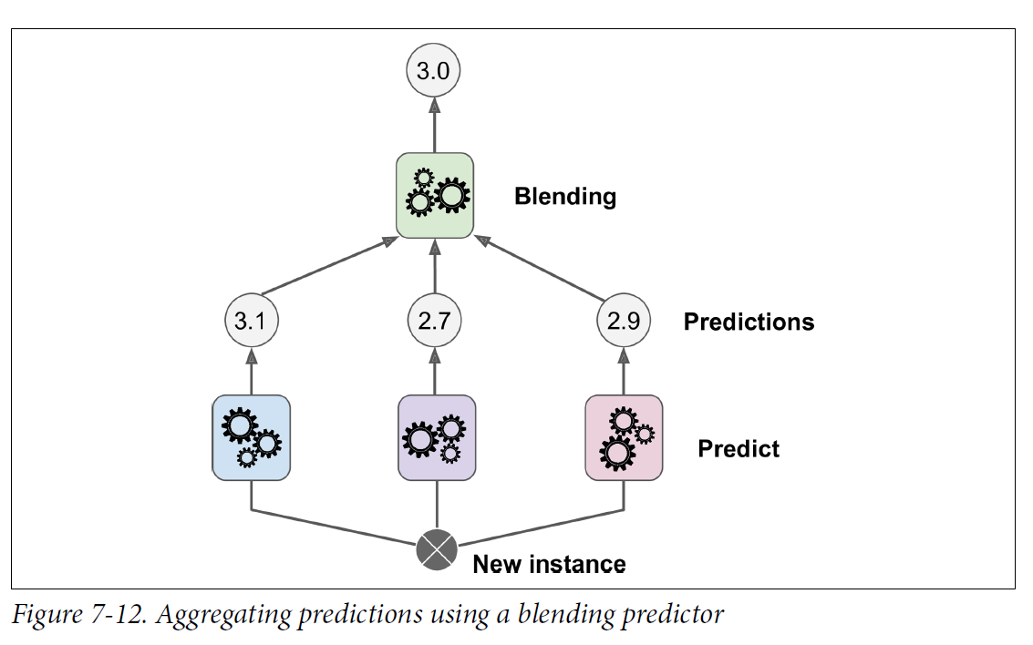
Stacking

Slide 84
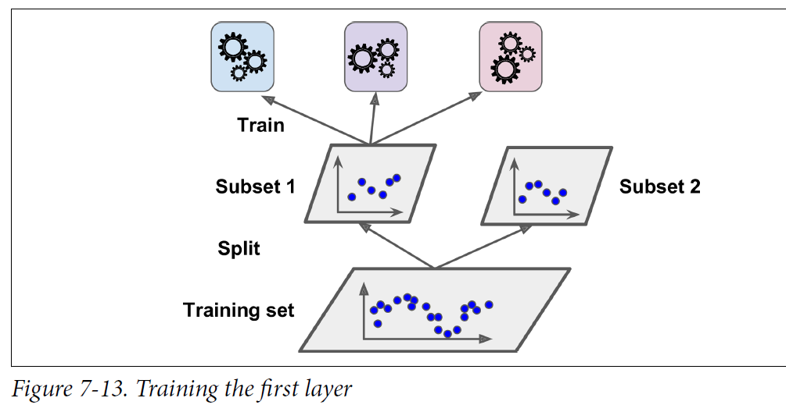
Stacking
To train the blender, a common approach is to use a hold-out set.
First, the training set is split into two subsets.
The first subset is used to train the predictors in the first layer (see Figure 7-13).

Slide 85
Stacking
Next, the first layer’s predictors are used to make predictions on the second (heldout) set (see Figure 7-14).
This ensures that the predictions are “clean,” since the predictors never saw these instances during training.
For each instance in the hold-out set, there are three predicted values.
We can create a new training set using these predicted values as input features (which makes this new training set 3D), and keeping the target values.
The blender is trained on this new training set, so it learns to predict the target value, given the first layer’s predictions.

Slide 86
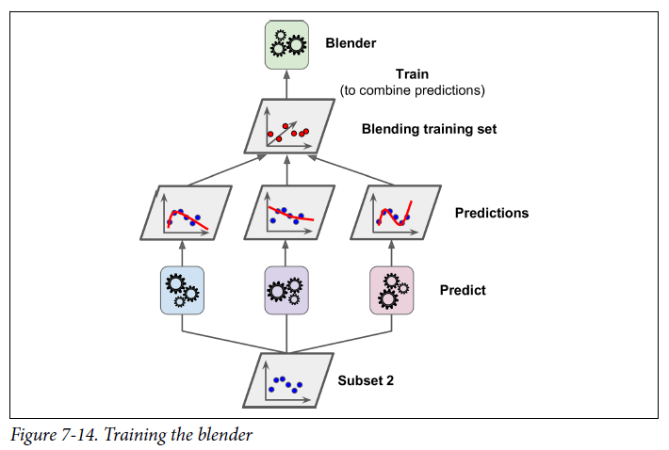
Stacking

Slide 87
Stacking
It is actually possible to train several different blenders this way (e.g., one using Linear Regression, another using Random Forest Regression), to get a whole layer of blenders.
The trick is to split the training set into three subsets: the first one is used to train the first layer, the second one is used to create the training set used to train the second layer (using predictions made by the predictors of the first layer),

Slide 88
Stacking
and the third one is used to create the training set to train the third layer (using predictions made by the predictors of the second layer).
Once this is done, we can make a prediction for a new instance by going through each layer sequentially, as shown in Figure 7-15.

Slide 89
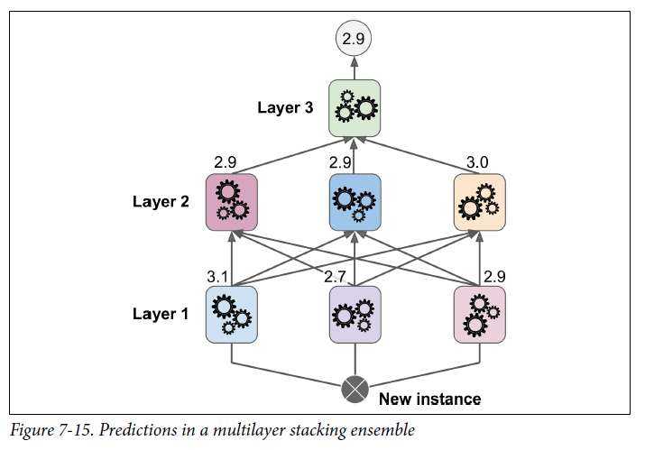
Stacking

